Slide 1
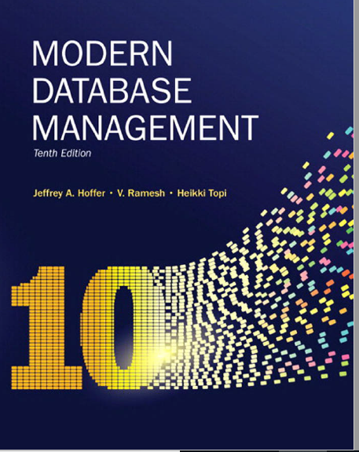
Chapter 9: Data Warehousing

Slide 2

Objectives
Define terms
Explore reasons for information gap between information needs and availability
Understand reasons for need of data warehousing
Describe three levels of data warehouse architectures
Describe two components of star schema
Design a data mart
Develop requirements for a data mart
Notes:
Most companies have some sort of data warehouse. What is data DW? What is a DM? What is a DSS?
Explore reasons for information gap between information needs and availability -> lots of data available, how is that data being used?
Understand reasons for need of data warehousing -> why is data DW important?
Describe three levels of data warehouse architectures -> pros and cons of each
Describe two components of star schema -> what is a star schema,
Design a data mart
Develop requirements for a data mart

Slide 3
Definition
Data Warehouse
A subject-oriented, integrated, time-variant, non-updatable collection of data used in support of management decision-making processes
Subject-oriented: e.g. customers, patients, students, products
Integrated: consistent naming conventions, formats, encoding structures; from multiple data sources
Time-variant: can study trends and changes
Non-updatable: read-only, periodically refreshed
Data Mart
A data warehouse that is limited in scope
Notes:
DW - a large DB store to guide management decisions.
is a system used for reporting and data analysis, and is considered a core component of business intelligence.
Data mart -A data warehouse that is limited in scope
Unlike operational system, DW is subject oriented to make useful for decision makers.
Integrated – different sources, info needs to be integrated, same naming convention
Time is important -> analysis of trends of time. To predict the future you must understand the past

Slide 4
Need for Data Warehousing
Integrated, company-wide view of high-quality information (from disparate databases)
Separation of operational and informational systems and data (for improved performance)
Notes:
Data in operational systems are not consistent. You may have different vendors for different parts of your operational systems!
There is a need to have a wider view of the company!
Running analytical queries on top of operational system is not advisbile, they are build for different purpose. The info is not organized to achieve that.

Slide 5
Issues with Company-Wide View
Inconsistent key structures
Synonyms
Free-form vs. structured fields
Inconsistent data values
Missing data
See figure 9-1 for example
Notes:
Inconsistent key structures – primary keys and FKs are not the same
Synonyms -> naming convention and metadata may not be the same
Free-form vs. structured fields
Inconsistent data values
Missing data

Slide 6
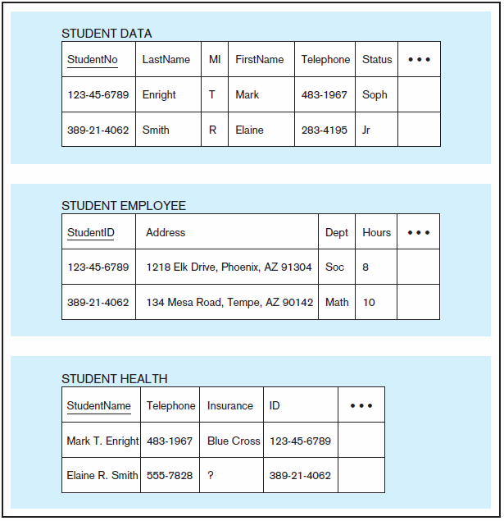
Figure 9-1 Examples of heterogeneous data
Notes:
Student ID with inconsistent metadata name: StudentID, StudentNo, ID.
Missing Data, etc.
In one table name is in 3 columns, in another it is in one column

Slide 7
Organizational Trends Motivating Data Warehouses
No single system of records
Multiple systems not synchronized
Organizational need to analyze activities in a balanced way
Customer relationship management
Supplier relationship management
Notes:
Organizations saw that there isn’t one place to get “One version of the truth”!!!
Multiple systems aren’t integrated. Specially in the case on M and A, you may have two system with customer information. If you want to do wholistic customer analysis, you cant
Organizational need to analyze activities in a balanced way – considering multiple facets of the company
CRM- 360 view of the customer
Supplier – supply chain analytics

Slide 8
Separating Operational and Informational Systems
Operational system – a system that is used to run a business in real time, based on current data; also called a system of record
Informational system – a system designed to support decision making based on historical point-in-time and prediction data for complex queries or data-mining applications
Datawarehouse = informational system
Notes:
They way operational systems are build, they are build to be the system of record, and run the operations.
Informational systems is designed to support decision making

Slide 9
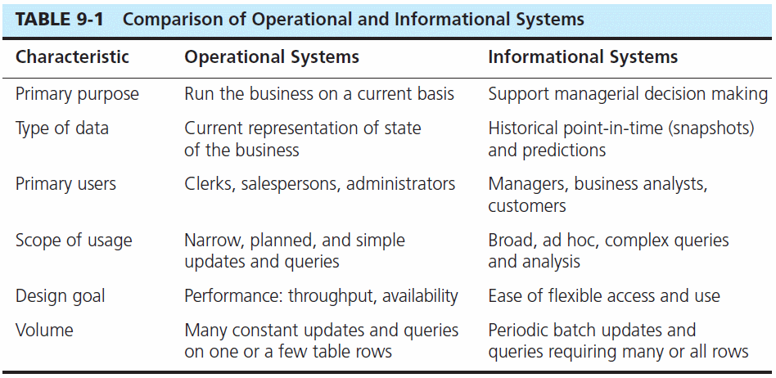

Slide 10
Data Warehouse Architectures
Independent Data Mart
Dependent Data Mart and Operational Data Store
Logical Data Mart and Real-Time Data Warehouse
All involve some form of extract, transform and load (ETL)

Slide 11
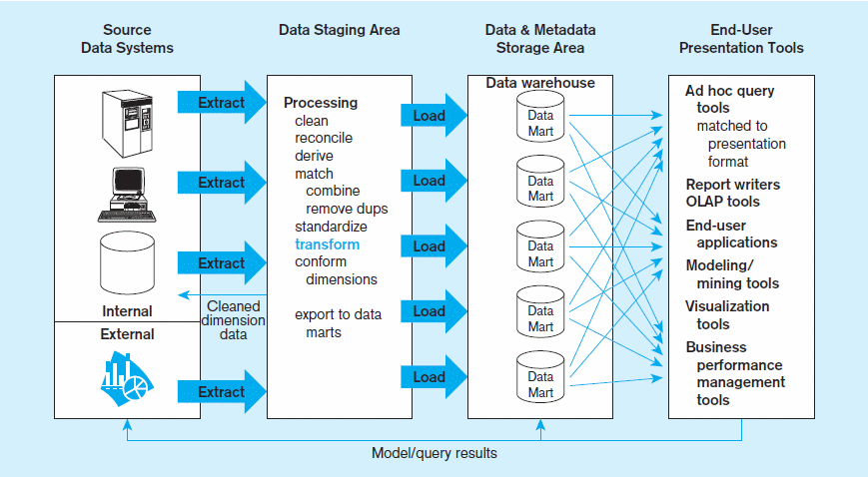
Figure 9-2 Independent data mart data warehousing architecture
Data marts:
Mini-warehouses, limited in scope
L
T
E
Separate ETL for each independent data mart
Data access complexity due to multiple data marts
Notes:
What is the advantage of this model:
Time, phased approach. You can take t your time to do 1 data mart at a time.
Disadvantage, no enterprise view of the organization. Data still isn’t centralized
ETL Tools: SSIS, Informatica
Visualization Tools: PowerBI, Tableau, MicroStrategy, SSRS, Excel

Slide 12
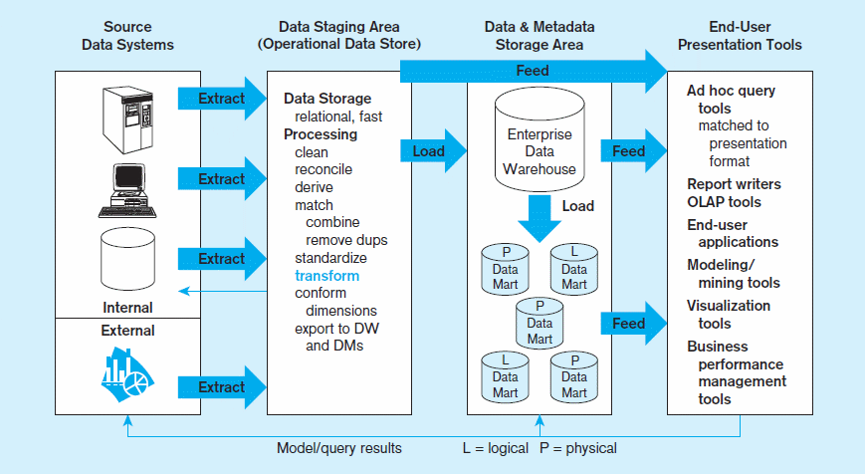
Figure 9-3 Dependent data mart with operational data store: a three-level architecture
ODS provides option for obtaining current data
L
T
E
Simpler data access
Single ETL for
enterprise data warehouse (EDW)
Dependent data marts loaded from EDW
Notes:
Advantage: single view of the organization, data centralized in EDW.
Disadvantage : takes longer to implement.
OLAP – Online Analytical processing

Slide 13
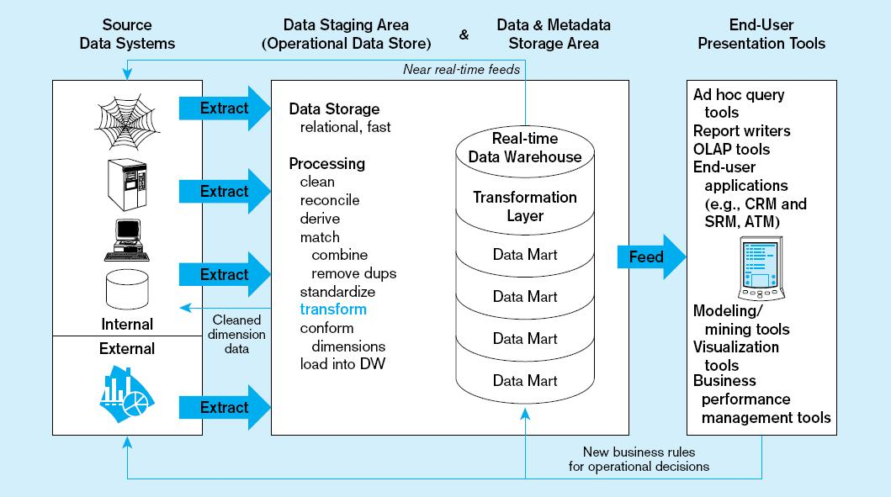
Figure 9-4 Logical data mart and real time warehouse architecture
ODS and data warehouse are one and the same
L
T
E
Data marts are NOT separate databases, but logical views of the data warehouse
➔ Easier to create new data marts
Near real-time ETL for
Data Warehouse
Notes:
Near real time feed to DW.
Advantages: real time data, save on storage.
Dissaving: need powerful machines. ExaData, Neteza, TerraData

Slide 14
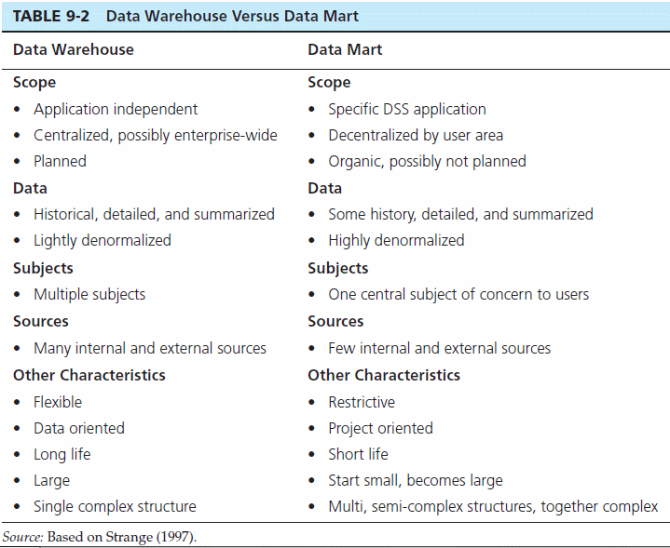
Source: adapted from Strange (1997).

Slide 15
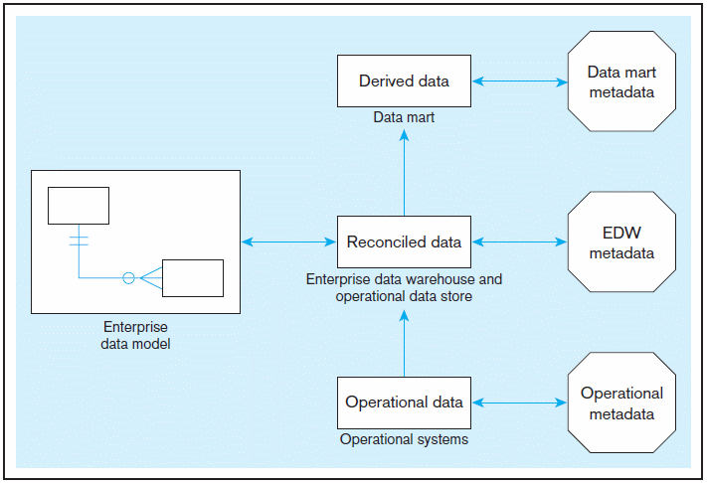
Figure 9-5 Three-layer data architecture for a data warehouse
Notes:
Operational systems
EDW
Data Marta

Slide 16
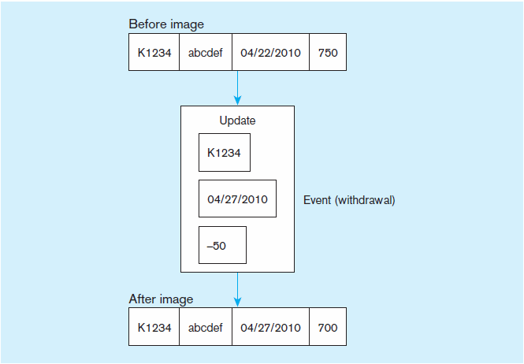
Data Characteristics Status vs. Event Data
Figure 9-6 Example of DBMS log entry
Status
Event = a database action (create/ update/ delete) that results from a transaction
Status

Slide 17
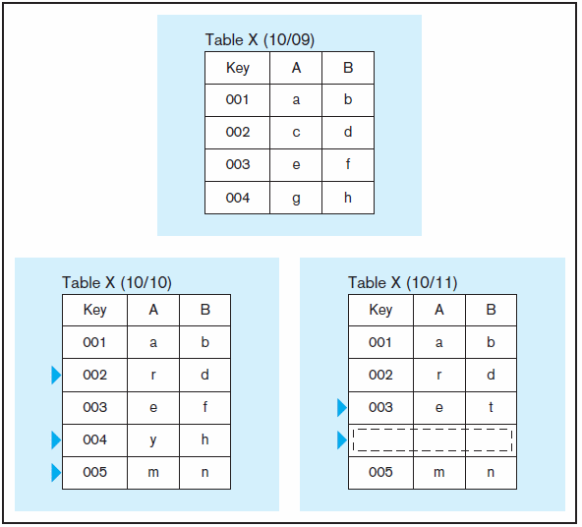
Figure 9-7 Transient operational data
Data Characteristics Transient vs. Periodic Data
With transient data, changes to existing records are written over previous records, thus destroying the previous data content
Notes:
An important concept of DW is how data is stored to capture TREND!
Consider this example on how data chainges
transient data -changes to existing records are written over previous records, thus destroying the previous data content

Slide 18
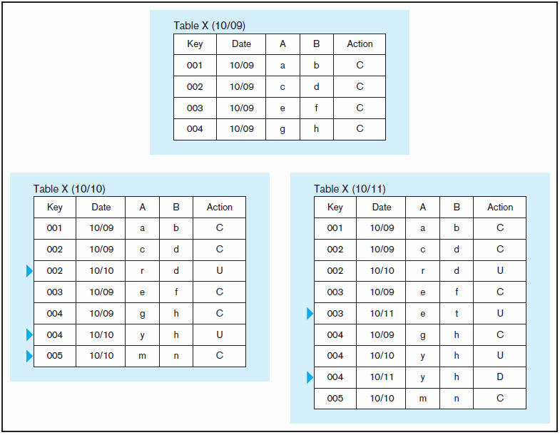
Data Characteristics Transient vs. Periodic Data
Figure 9-8 Periodic warehouse data
Periodic data are never physically altered or deleted once they have been added to the store
Notes:
Period -> data are never physically altered or deleted once they have been added to the store

Slide 19
Derived Data
Objectives
Ease of use for decision support applications
Fast response to predefined user queries
Customized data for target audiences
Ad-hoc query support
Data mining capabilities
Characteristics
Detailed (mostly periodic) data
Aggregate (for summary)
Distributed (to departmental servers)
Most common data model = star schema
(also called “dimensional model”)
Notes:
Derived data - formatted, and aggregated for end-user decision support applications.
A lot of the data in DW, is not stored the same way as operational. Data can be derived:

Slide 20
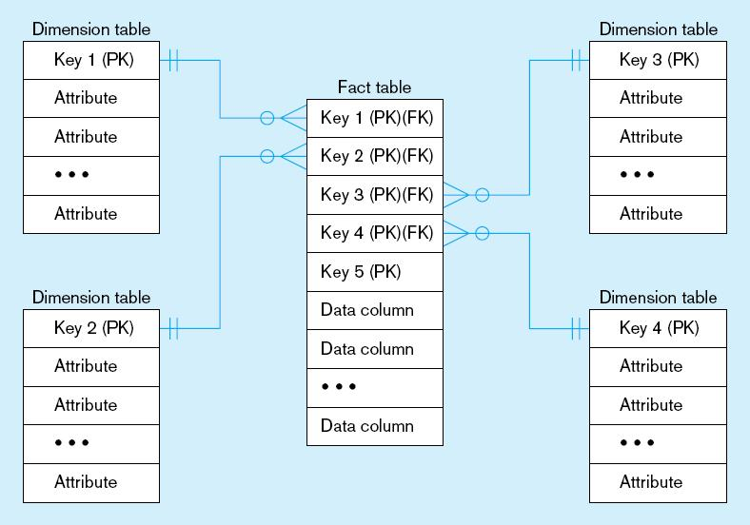
Figure 9-9 Components of a star schema
Fact tables contain factual or quantitative data
1:N relationship between dimension tables and fact tables
Dimension tables are denormalized to maximize performance
Dimension tables contain descriptions about the subjects of the business
Excellent for ad-hoc queries, but bad for online transaction processing
Notes:
FACT Table - contains factual or quantitative data, business activities -> comes from associative entities
FK to associative dimension tables
PK = composite key of all FKs
All other non key attributes are measures or metrics to measure the business.
Dimension table – descriptions of subject of the business
PK – which is often a surrogate key
All other attributes describes to subject
Relationship -> All 1 to many from Dim to FACT

Slide 21
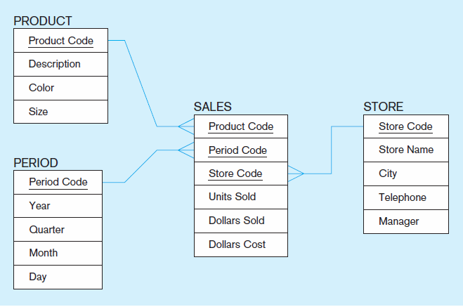
Figure 9-10 Star schema example
Fact table provides statistics for sales broken down by product, period and store dimensions
Notes:
Sales FACT – info about quantity and amounts sold and cost
DIM – product period , and store.
What kind of questions can we ask?
Show trends per product/ per location
show products that is more profitable
Show fastest growing segment of the business, where are we selling the them

Slide 22
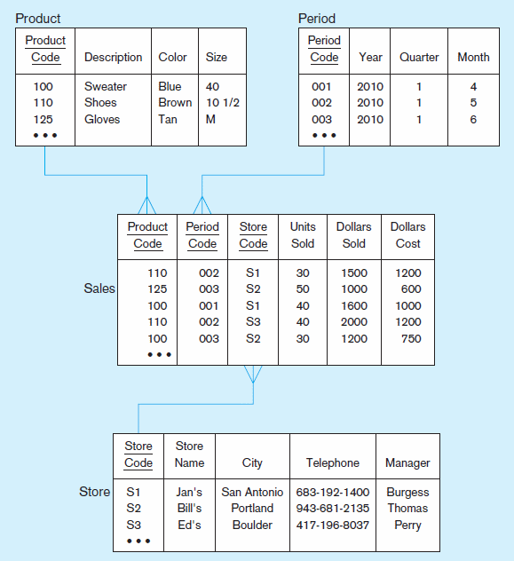
Figure 9-11 Star schema with sample data
Notes:
In this example here, which table is a FACT, which are Dim?
Two types of attributes in sales Fact: FK, and numeric values for the quantifies
Dimension tables – enough attributes to define the business description

Slide 23
Surrogate Dimension Keys
Dimension table keys should be surrogate (non-intelligent and non-business related), because:
Business keys may change over time
Helps keep track of nonkey attribute values for a given production key
Surrogate keys are simpler and shorter
Surrogate keys can be same length and format for all keys
Notes:
The relationship between FACT and DIM is done via a surrogate key.
Business keys may change over time -> in operational system keys may change
Helps keep track of nonkey attribute values for a given production key -? Non key attribute changes such as marriage for example last name changes
Surrogate keys are simpler and shorter
Surrogate keys can be same length and format for all keys

Slide 24
Grain of the Fact Table
Granularity of Fact Table–what level of detail do you want?
Transactional grain–finest level
Aggregated grain–more summarized
Finer grains ➔ better market basket analysis capability
Finer grain ➔ more dimension tables, more rows in fact table
In Web-based commerce, finest granularity is a click
Notes:
How granular do you want to design your FACT table to be?
The more granular the data, more records will have.
In telecom, ca call record is the most granular, you may want to summarize by TN and Date!!
More granular is typically better, however it is more work

Slide 25
Duration of the Database
Natural duration–13 months or 5 quarters
Financial institutions may need longer duration
Older data is more difficult to source and cleanse
Notes:
13 months enables you do trend analysis.
You may have to keep more data due to compliance. In Telecom we are required to have 7 years of calling records

Slide 26
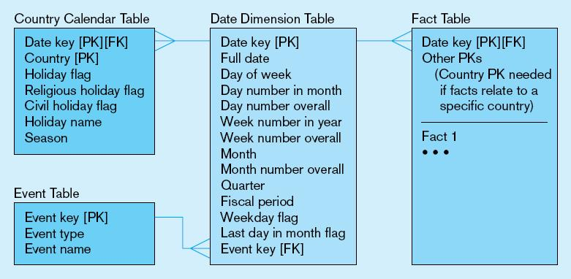
Figure 9-12 Modeling dates
Fact tables contain time-period data
➔ Date dimensions are important
Notes:
Because Trending is an important part of DW,
Literally every DW system has a Date dimension

Slide 27
Variations of the Star Schema
Multiple Facts Tables
Can improve performance
Often used to store facts for different combinations of dimensions
Conformed dimensions
Factless Facts Tables
No nonkey data, but foreign keys for associated dimensions
Used for:
Tracking events
Inventory coverage
Notes:
For bigger systems:
Multiple Facts Tables -> perhaps one fact table to measure different aspect, division. Some companies have business that are completely different, in that case you may need different dimension
Factless Facts Tables -> for measure events. Something either happened or didn’t happen

Slide 28
Slowly Changing Dimensions (SCD)
Need to maintain knowledge of the past
One option: for each changing attribute, create a current value field and many old-valued fields (multivalued)
Better option: create a new dimension table row each time the dimension object changes, with all dimension characteristics at the time of change
Notes:
The process of capturing dimension changes over time is called SCD! Example might be a person chaging their last name.
Draw an example of person’s getting married change

Slide 29
Example of SCD Type 2
Records from operational system
EmpID | FirstName | LastName | Address | StartDate
E100 | Joseph | Smith | 101 Main St | 1/1/2019
E200 | Raj | Boopathy | 30 Ames Ave | 2/2/2019
E300 | Sarah | Lee | 15 Water St | 2/15/2019

Slide 30
Example of SCD Type 2
Records from operational system
EmpID | FirstName | LastName | Address | StartDate
E100 | Joseph | Smith | 101 Main St | 1/1/2019
E200 | Raj | Boopathy | 30 Ames Ave | 2/2/2019
E300 | Sarah | Lee | 15 Water St | 2/15/2019
Records from the Employee Dimension
SK_EmpID | EmpID | FirstName | LastName | Address | StartDate | RecDate | Current
1 | E100 | Joseph | Smith | 101 Main St | 1/1/2019 | 3/1/19 | 1
2 | E200 | Raj | Boopathy | 30 Ames Ave | 2/2/2019 | 3/1/19 | 1
3 | E300 | Sarah | Lee | 15 Water St | 2/15/2019 | 3/1/19 | 1

Slide 31
Operational System changes
EmpID | FirstName | LastName | Address | StartDate
E100 | Joseph | Smith | 101 Main St | 1/1/2019
E200 | Raj | Boopathy | 30 Ames Ave | 2/2/2019
E300 | Sarah | Lopez | 15 Water St | 2/15/2019
Records from operational system 3/14/19
Sarah gets married, last name changes to from Lee to Lopez

Slide 32
Processing changes
SK_EmpID | EmpID | FirstName | LastName | Address | StartDate | RecDate | Current
1 | E100 | Joseph | Smith | 101 Main St | 1/1/2019 | 3/1/19 | 1
2 | E200 | Raj | Boopathy | 30 Ames Ave | 2/2/2019 | 3/1/19 | 1
3 | E300 | Sarah | Lee | 15 Water St | 2/15/2019 | 3/1/19 | 0
4 | E300 | Sarah | Lopez | 15 Water St | 2/15/2019 | 3/14/19 | 1
Records from the Employee Dimension

Slide 33
10 Essential Rules for Dimensional Modeling
Use atomic facts
Create single-process fact tables
Include a date dimension for each fact table
Enforce consistent grain
Disallow null keys in fact tables
Honor hierarchies
Decode dimension tables
Use surrogate keys
Conform dimensions
Balance requirements with actual data
Notes:
Use atomic facts –detailed data point you have available
Create single-process fact tables - address the important measurements for one business process such as customer order taking
Include a date dimension for each fact table
Enforce consistent grain - Each measurement in a fact table must be atomic for the same combination of keys (the same grain).
Disallow null keys in fact tables – every Dim Table should have a N/A row

Slide 34
The User Interface Metadata (data catalog)
Identify subjects of the data mart
Identify dimensions and facts
Indicate how data is derived from enterprise data warehouses, including derivation rules
Indicate how data is derived from operational data store, including derivation rules
Identify available reports and predefined queries
Identify data analysis techniques (e.g. drill-down)
Identify responsible people
Notes:
Data lineage

Slide 35
Online Analytical Processing (OLAP) Tools
The use of a set of graphical tools that provides users with multidimensional views of their data and allows them to analyze the data using simple windowing techniques
Relational OLAP (ROLAP)
Traditional relational representation
Multidimensional OLAP (MOLAP)
Cube structure
OLAP Operations
Cube slicing–come up with 2-D view of data
Drill-down–going from summary to more detailed views
Consolidation - roll up operations
Notes:
OLAP – Online Analytical processing Tool - tool to provide multi dimensional view of the Data.
Microsoft has an OLAP tool called SSAS

Slide 36
OLAP Tools
IBM Cognos
Microstrategy
Palo OLAP Server
Apache Kylin
Microsoft SSAS
Notes:
OLAP – Online Analytical processing Tool - tool to provide multi dimensional view of the Data.
Microsoft has an OLAP tool called SSAS

Slide 37
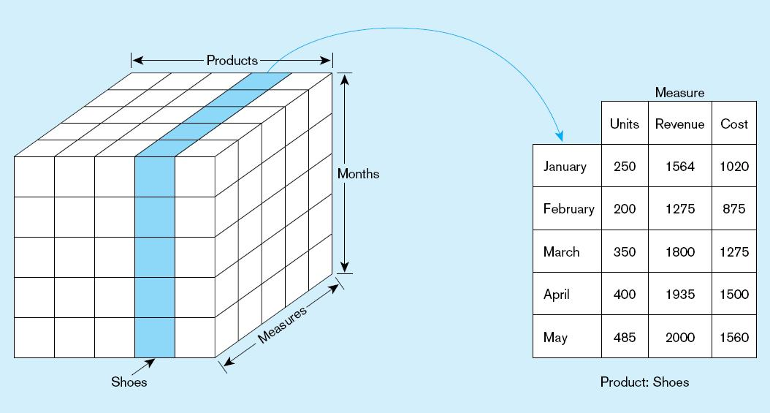
Figure 9-21 Slicing a data cube
Notes:
The function of slicing and dicing is a process in which data is viewed in two dimensional modeling!
You have your measures, and your dimensions

Slide 38
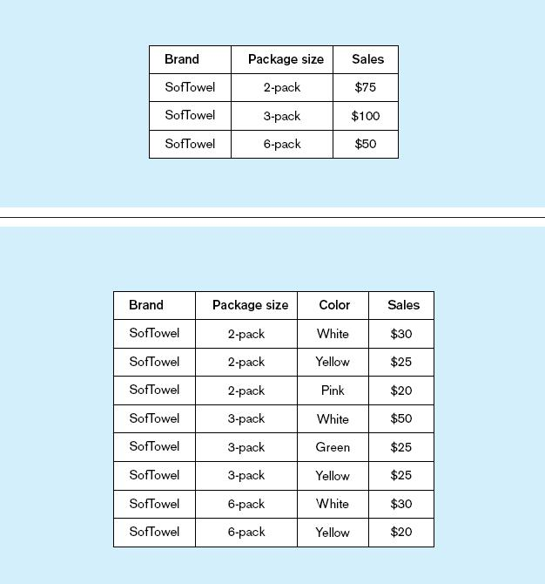
Summary report
Figure 9-22
Example of drill-down
Starting with summary data, users can obtain details for particular cells
Drill-down with color added
Notes:
Starting with summary data, click -through to view details

Slide 39
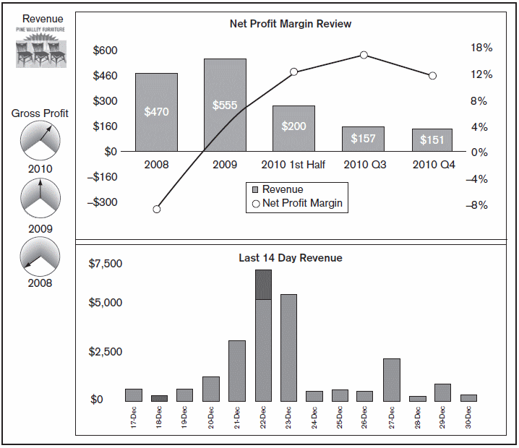
Business Performance Mgmt (BPM)
Figure 9-25
Sample Dashboard
BPM systems allow managers to measure,
monitor, and manage key activities and processes to achieve organizational goals.
Dashboards are often used to provide an information system in support of BPM.
Charts like these are examples of data visualization, the representation of data in graphical and multimedia formats for human analysis.
Notes:
BPM – are KPI that measures the business performance of a particular process.
Data presented as graphs is easier to read for human consuption

Slide 40
Data Mining
Knowledge discovery using a blend of statistical, AI, and computer graphics techniques
Goals:
Explain observed events or conditions
Confirm hypotheses
Explore data for new or unexpected relationships
Prediction
Notes:
Using Statistical Techniques, Data Analysists and Scientifics can mine the data

Slide 41
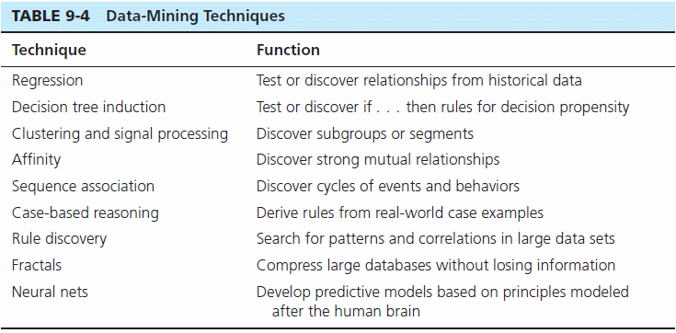
Notes:
Regression models – linear non linear regressions
Decision Trees
Clustering

